Slide 1







Weather
Weather
30
F
30
F
o
o
Something you need to know
Something you need to know
Please stay here! Dangerous outside
ACCESS CONTROL REQUIRE
3
Laboratory
2
Place your key in
this zone
1
Ground/1st floor
B

Slide 2

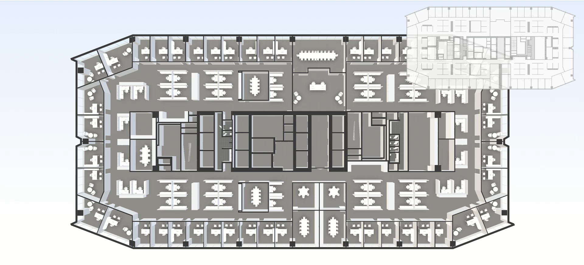
AI speak when reach floor, emergency situation or closing door
Display building map to guide user
Weather
Weather
30
F
30
F
o
o
Something you need to know
Something you need to know
Please stay here! Dangerous outside
ACCESS CONTROL REQUIRE
3
Laboratory
2
Place your key in
this zone
1
Ground/1st floor
B
Normal interface
Require access interface
Event interface

Slide 3



Slide 4
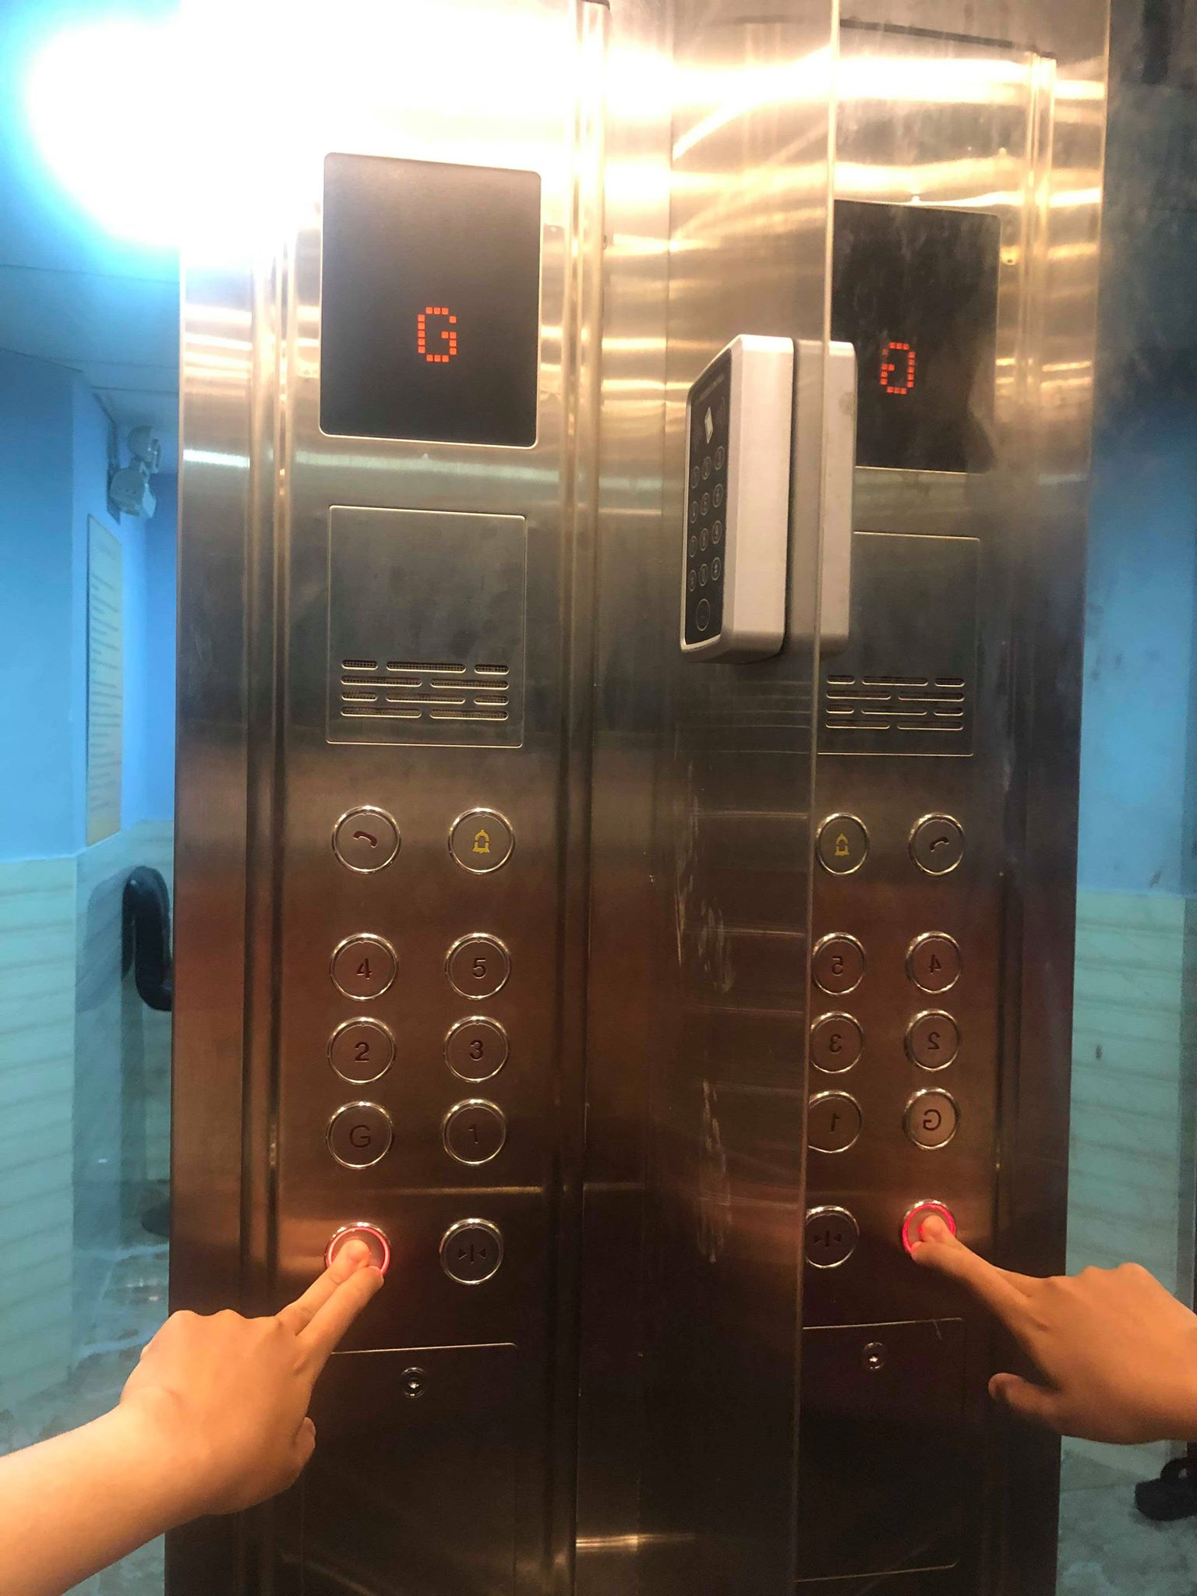
A
High
B

Slide 5
